Slide 1
Database CloudFront Elastic Container Service App runner Lambda/API gateway

Slide 2
RDS

Slide 3
Hands-on

Slide 4
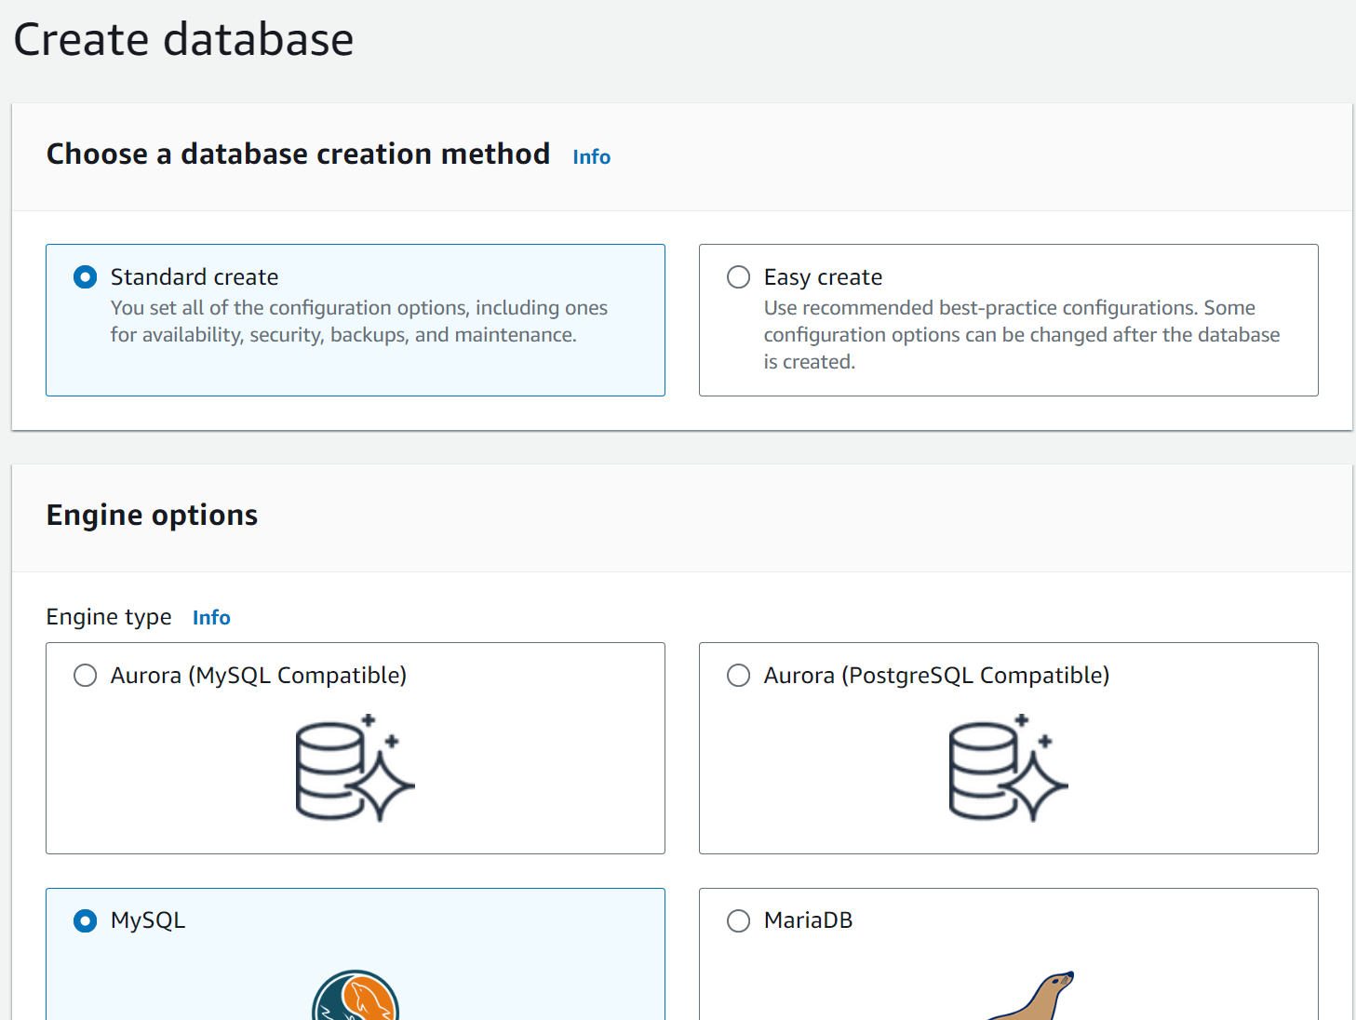
(1) Create RDS – Mysql option

Slide 5
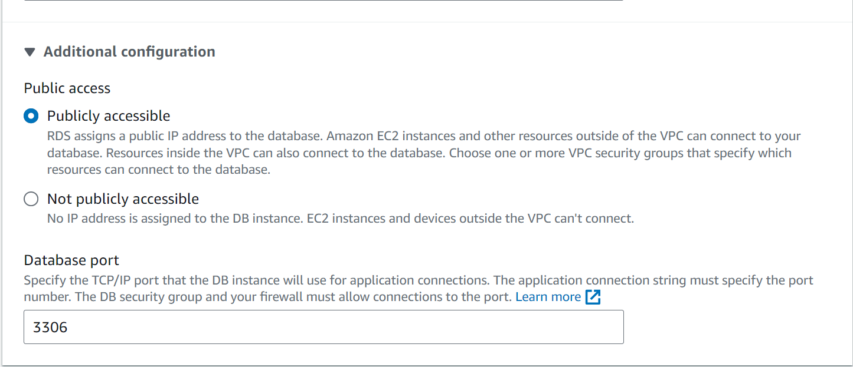
(1) Create RDS – Modify public access

Slide 6
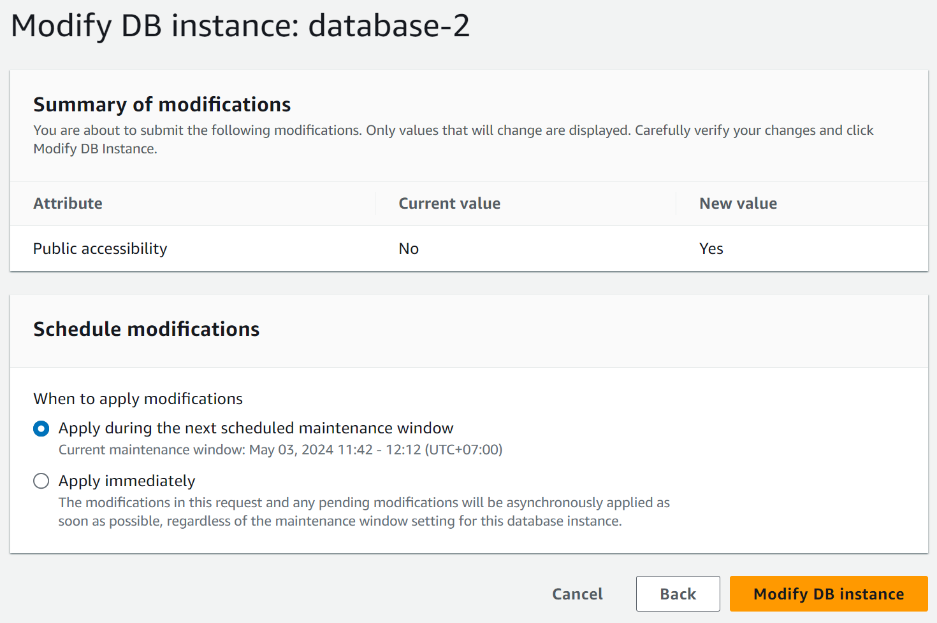
(1) Create RDS – Modify public access

Slide 7
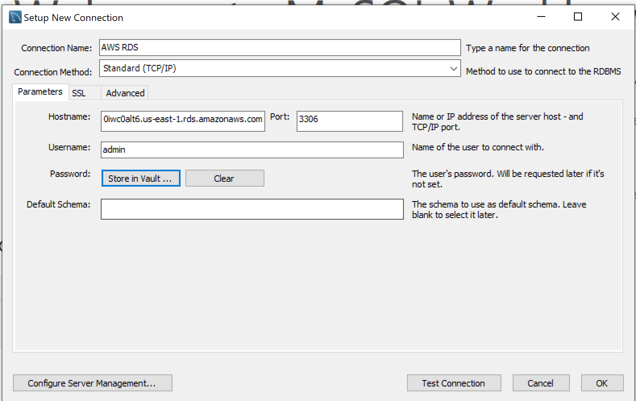
(2) Connect to RDS

Slide 8
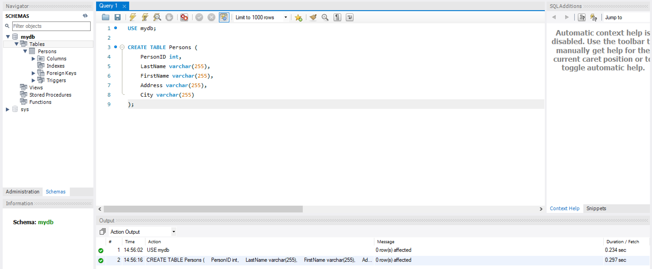
(3) Create table in RDS

Slide 9
ElastiCache

Slide 10
Hands-on

Slide 11
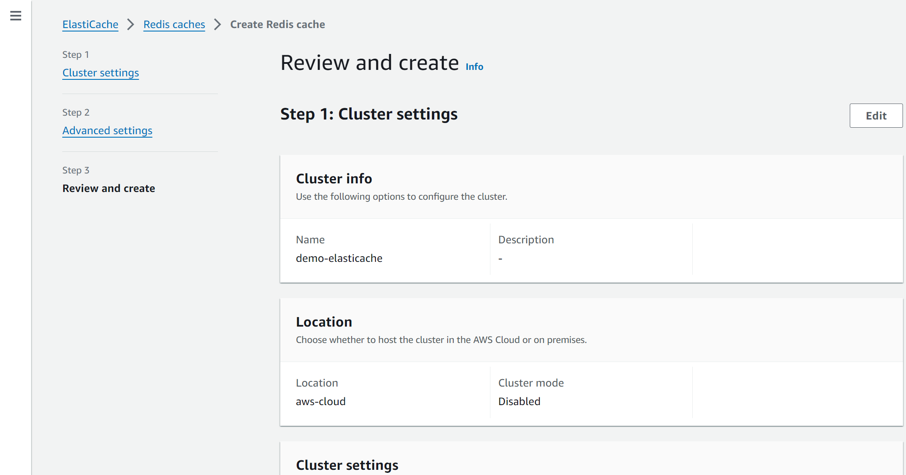
(1) Create ElastiCache – Redis type

Slide 12
(2) Connect to ElastiCache
Private -> create EC2 instance -> redis-cli

Slide 13
DynamoDB

Slide 14
Hands-on
CloudFrond vs S3

Slide 15
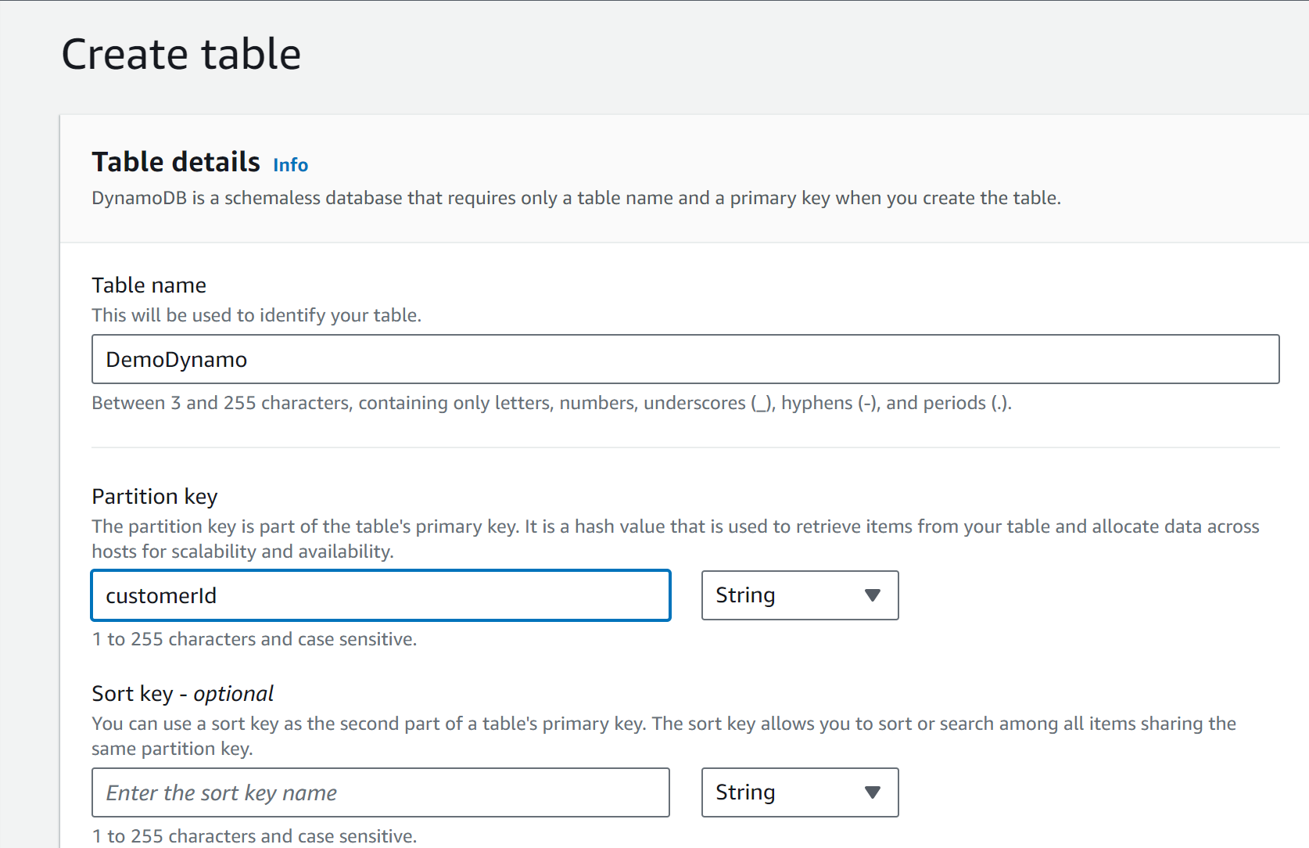
(1) Create table

Slide 16
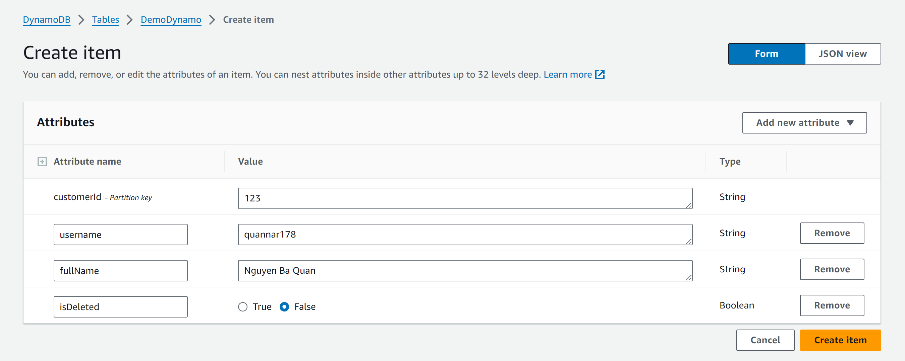
(2) Create item

Slide 17
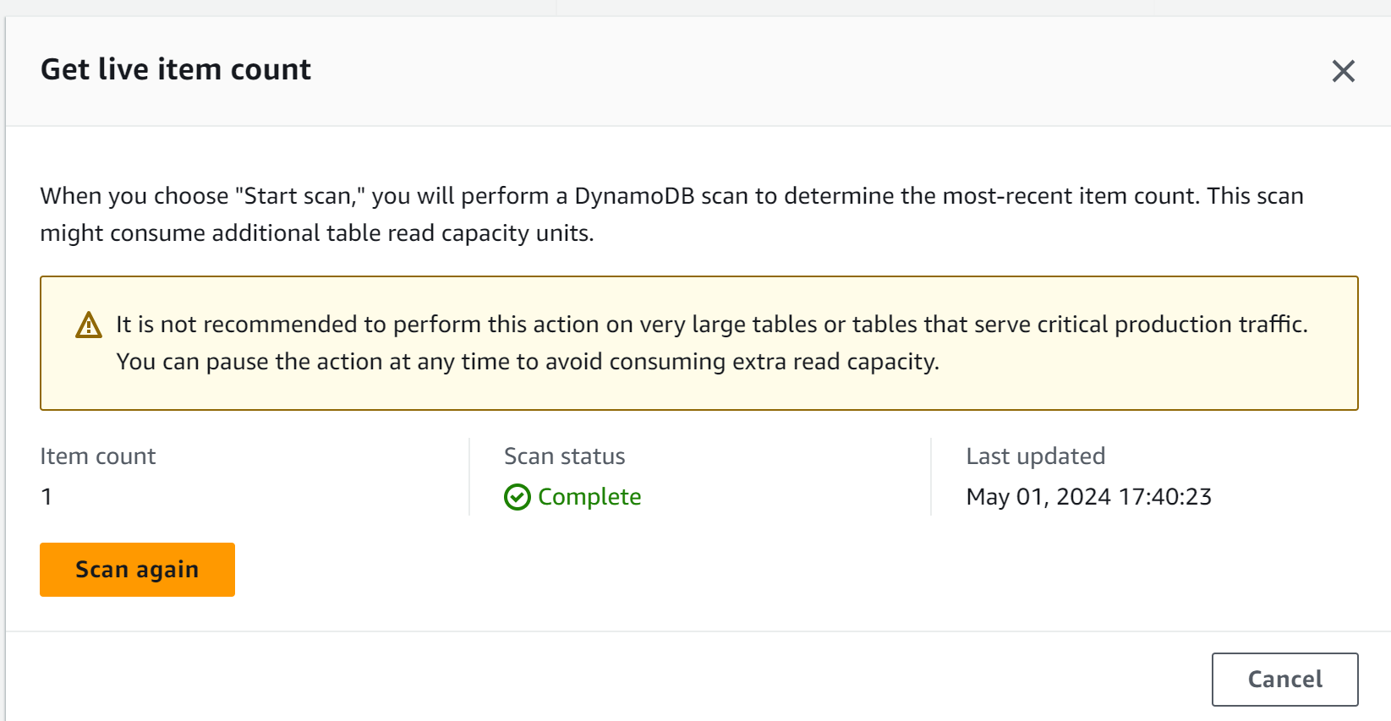
(2) Check item

Slide 18
Route53

Slide 19
Domain name system
DNS which translates the human friendly hostname into the machine IP address
Terminology
Domain registrar
Record: A, AAAA, CNAME, …
Zone file: contain record
Name server: resolve DNS queries

Slide 20
Hands-on

Slide 21
CloudFront

Slide 22
Hands-on
CloudFrond vs S3

Slide 23
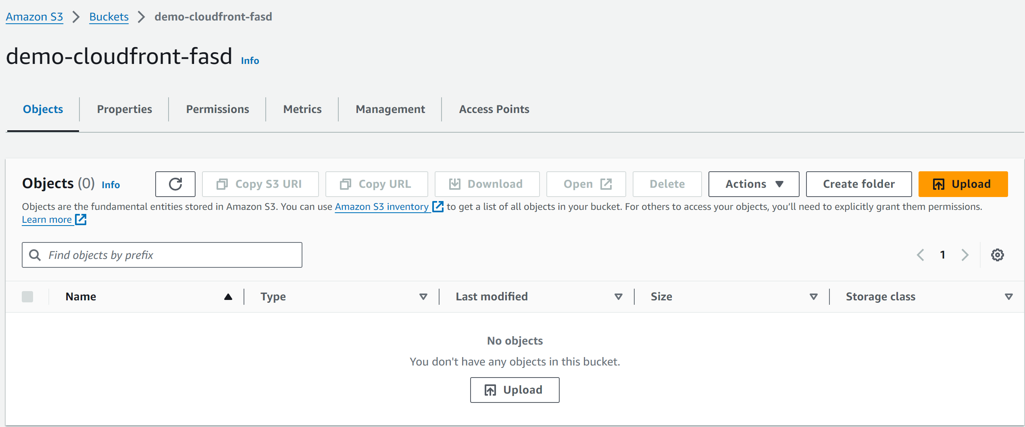
(1) Create S3 bucket

Slide 24
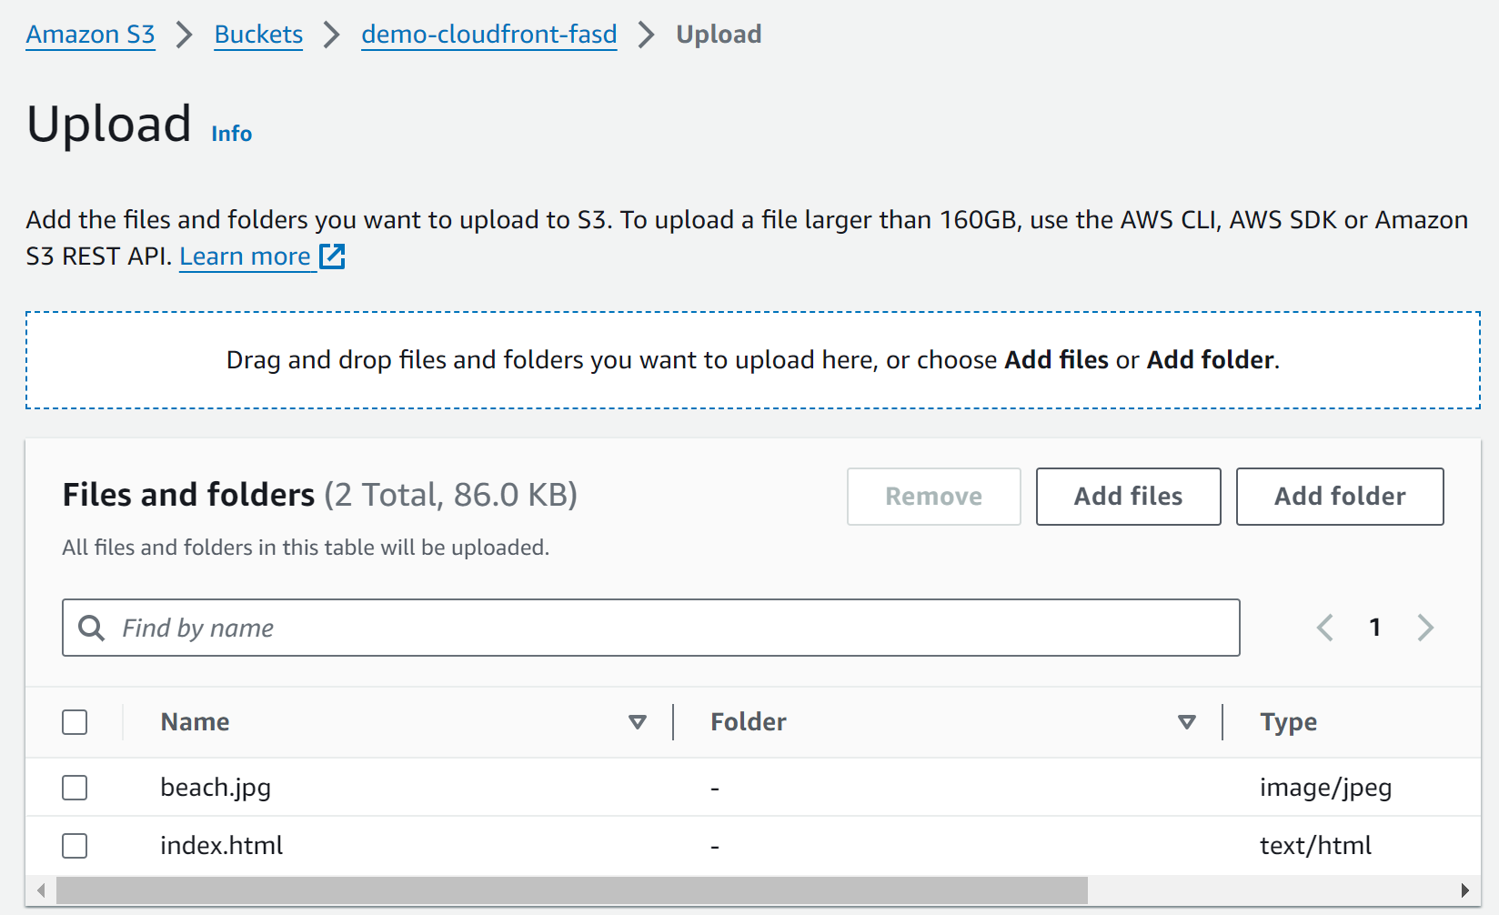
(1) Upload file to S3 bucket

Slide 25
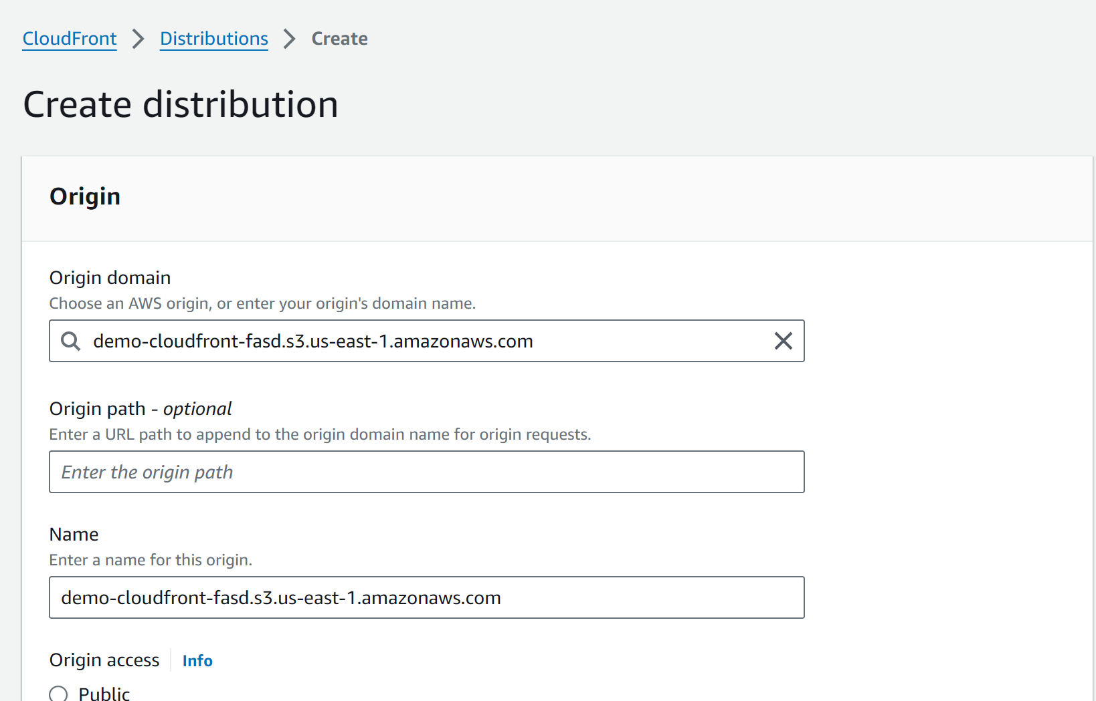
(2) Create CloudFront

Slide 26
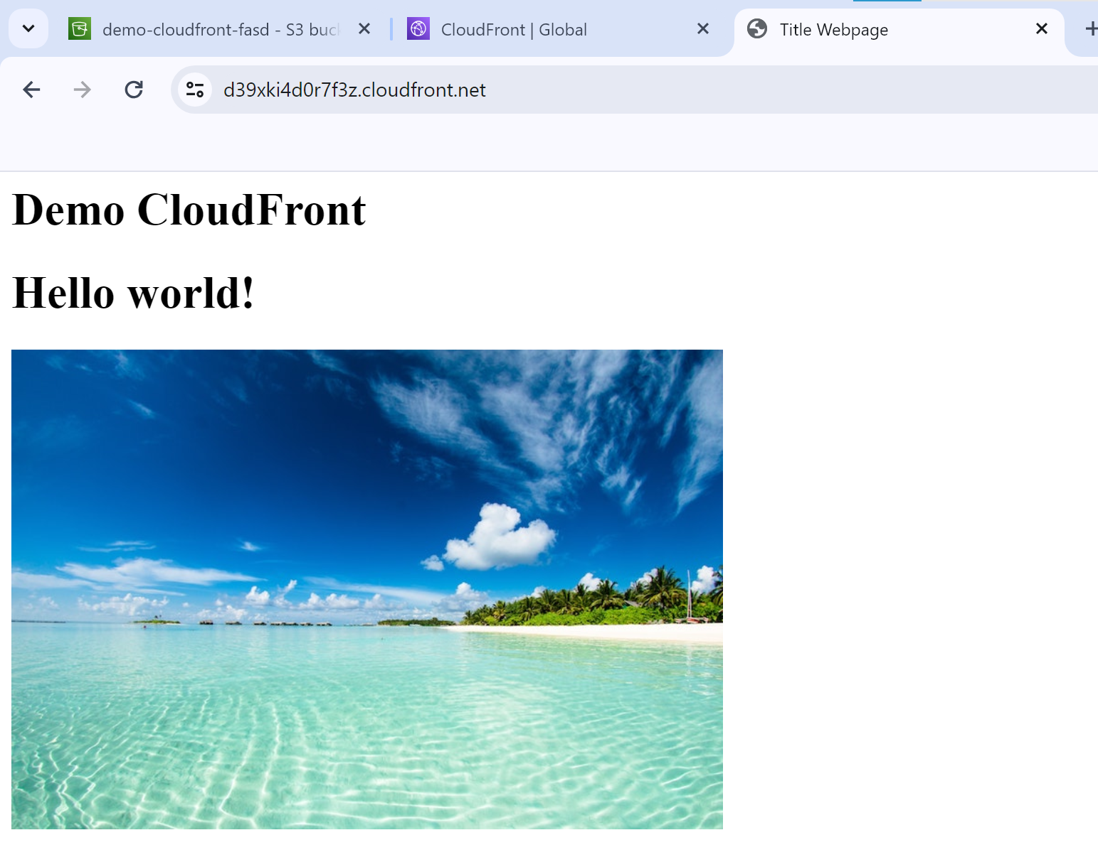
(3) Check result

Slide 27
ECS

Slide 28
Hands-on
CloudFrond vs S3

Slide 29
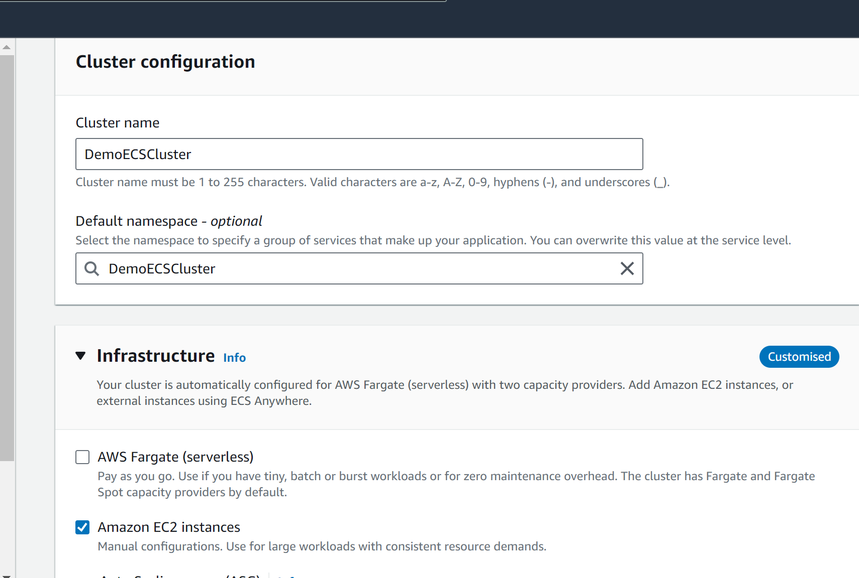
(1) Create ECS cluster

Slide 30
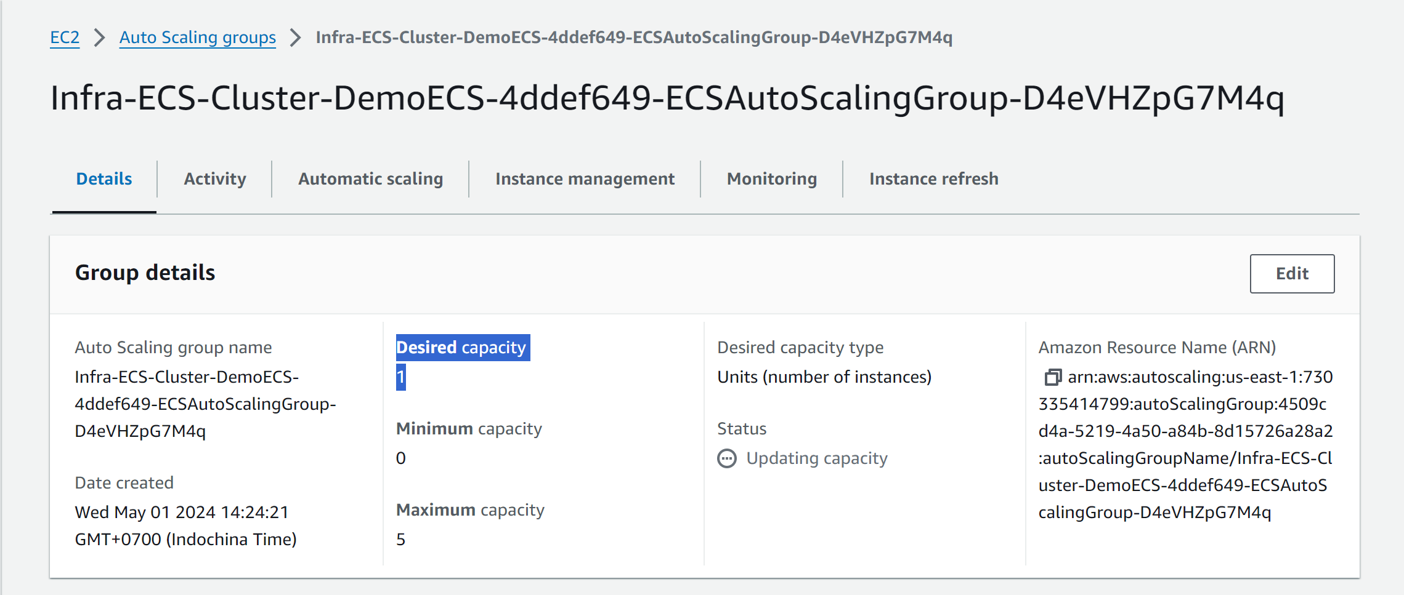
(2) Update ASG – Desire capacity

Slide 31
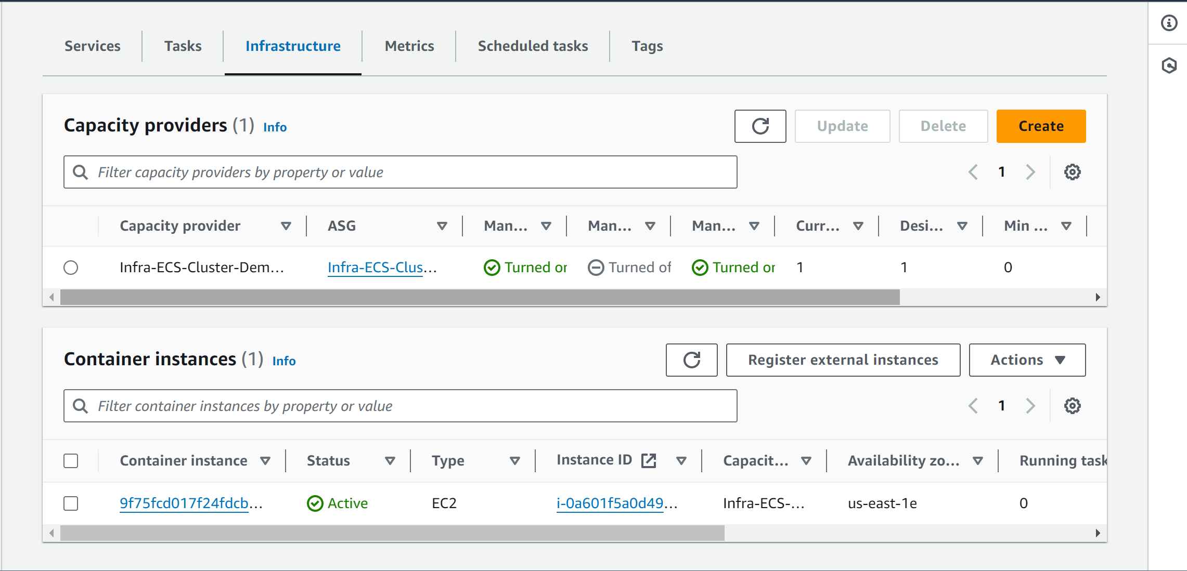
(2) Check ECS container instances

Slide 32
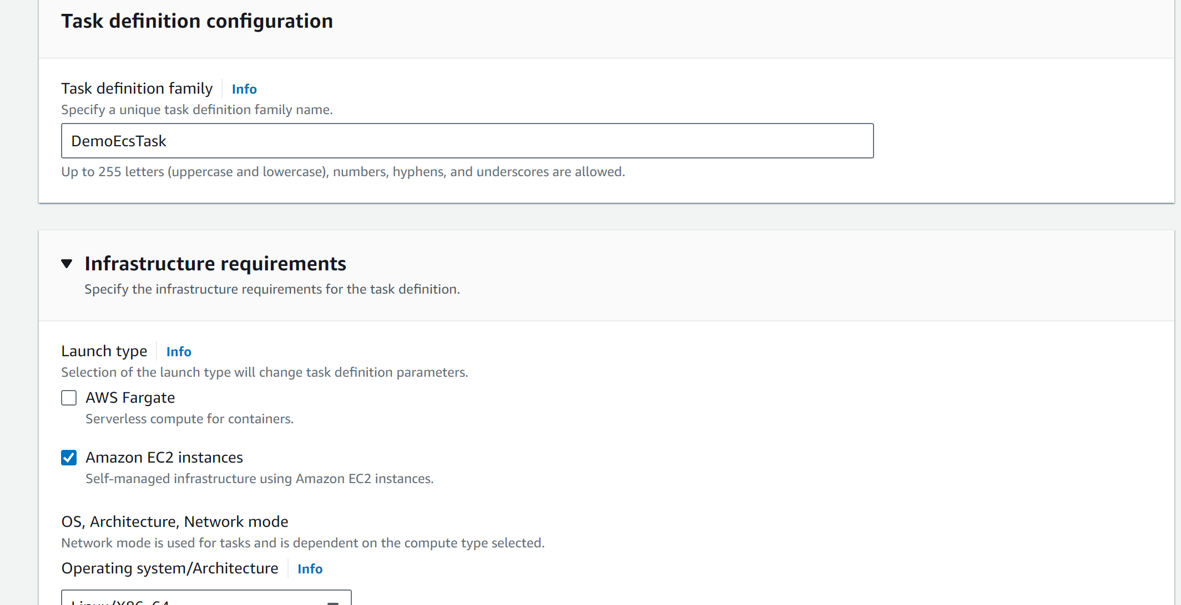
(3) Create ECS task

Slide 33
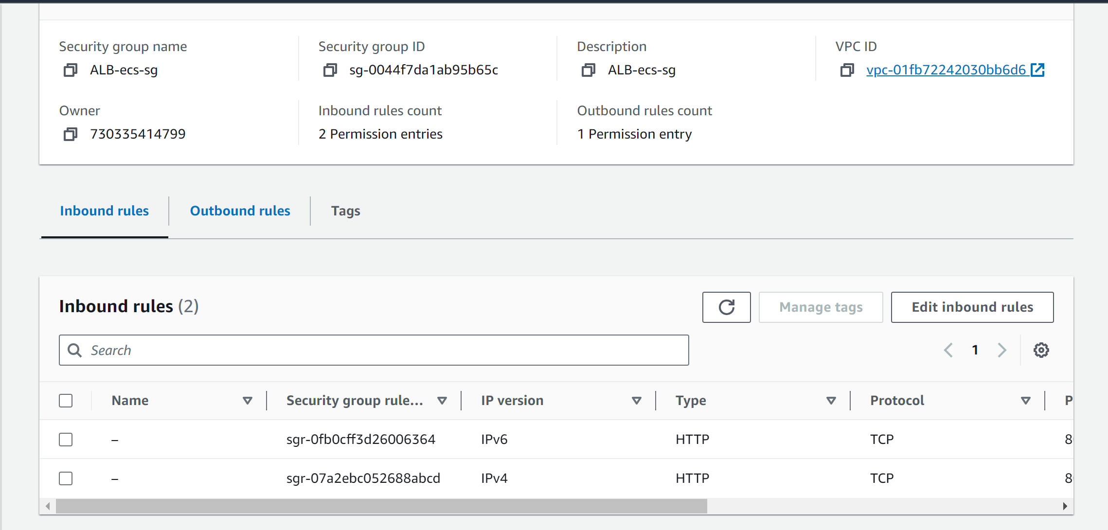
(4) Create SG for ALB

Slide 34
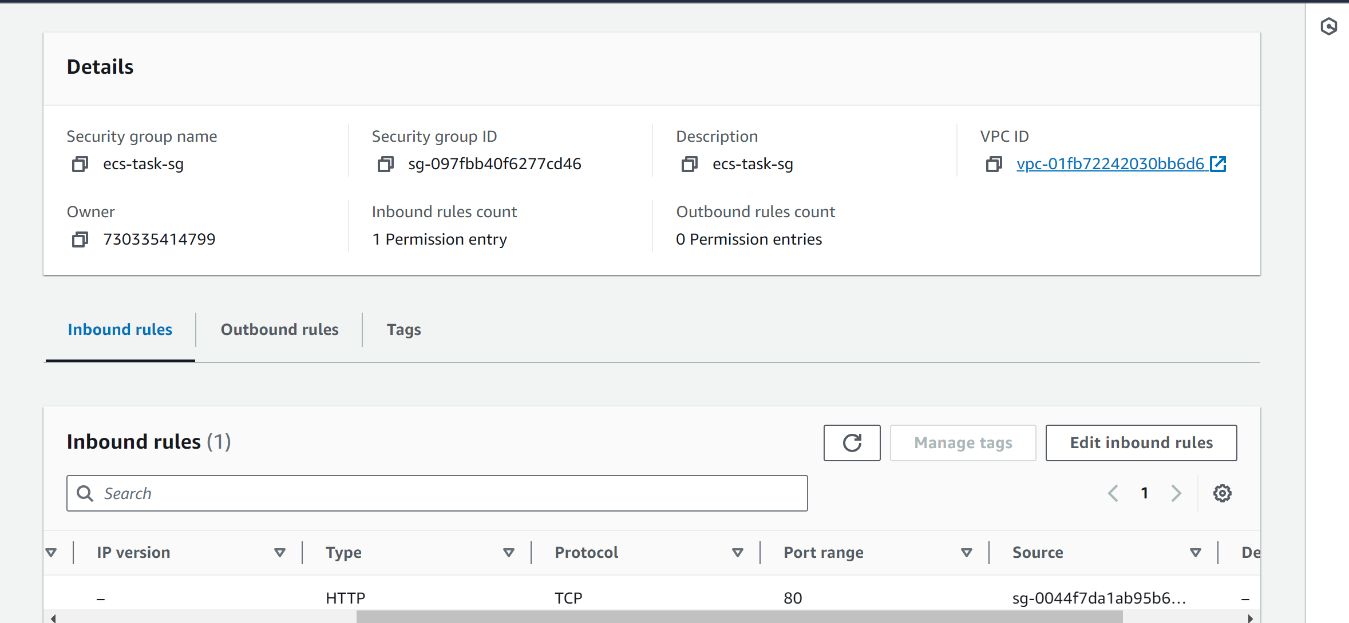
(4) Create SG for ECS task

Slide 35
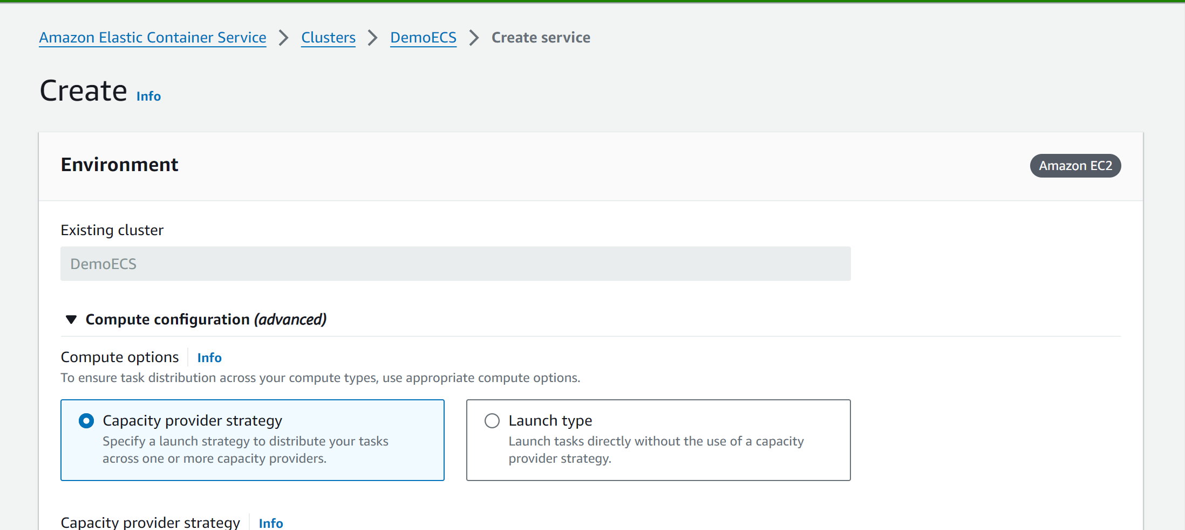
(5) Create ECS service

Slide 36
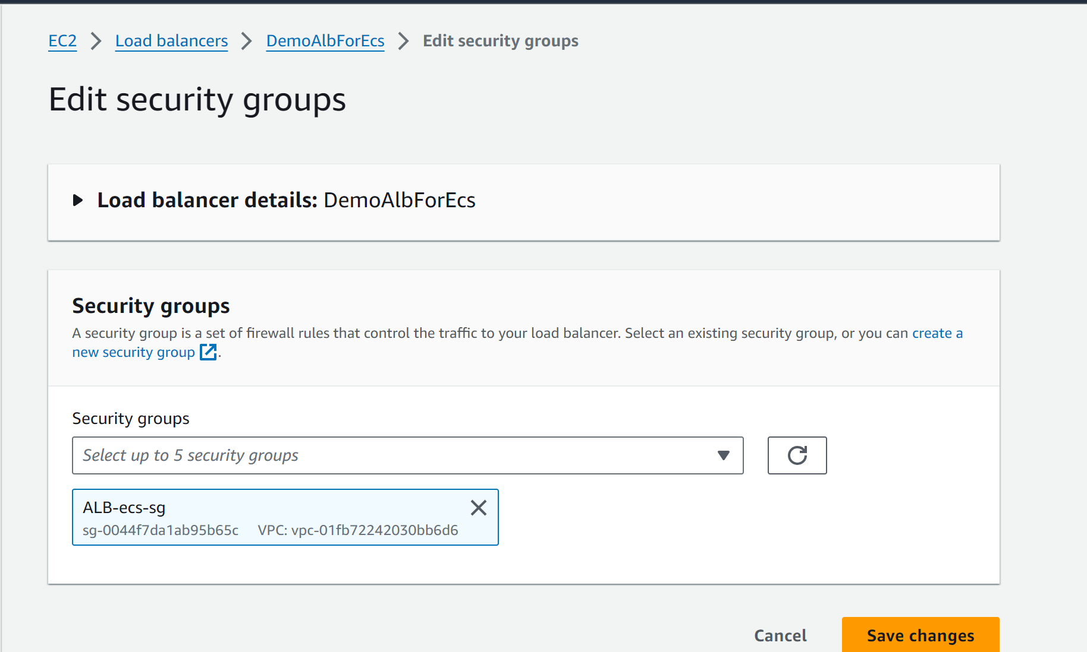
(5) Update security group for ALB

Slide 37
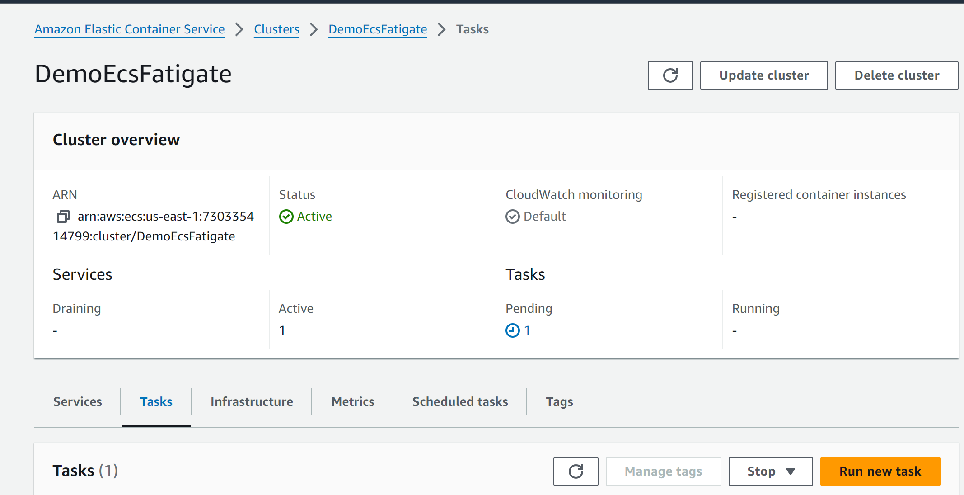
(5) Check ECS
Notes:
Error: resource is not enough

Slide 38
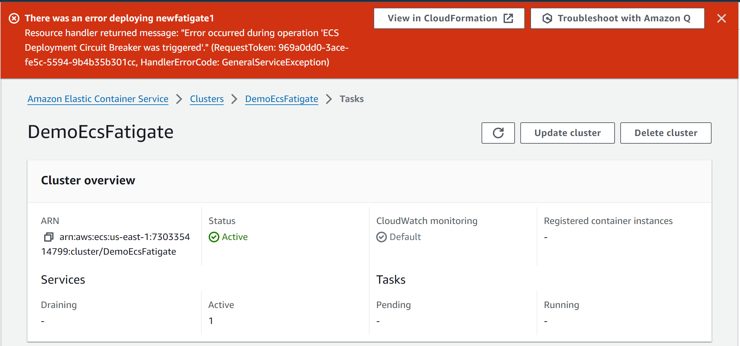
(5) Check ECS
Notes:
Error: resource is not enough

Slide 39
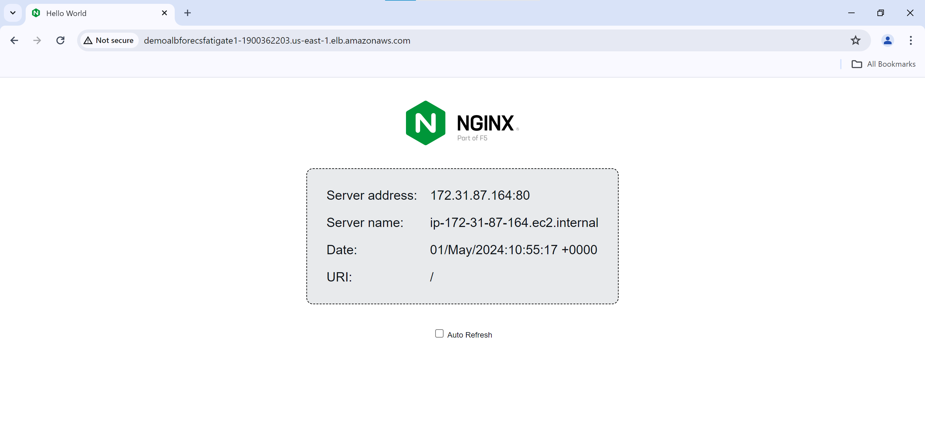
(5) Check ECS
Notes:
Error: resource is not enough

Slide 40
App runner

Slide 41
Hands-on
CloudFrond vs S3

Slide 42
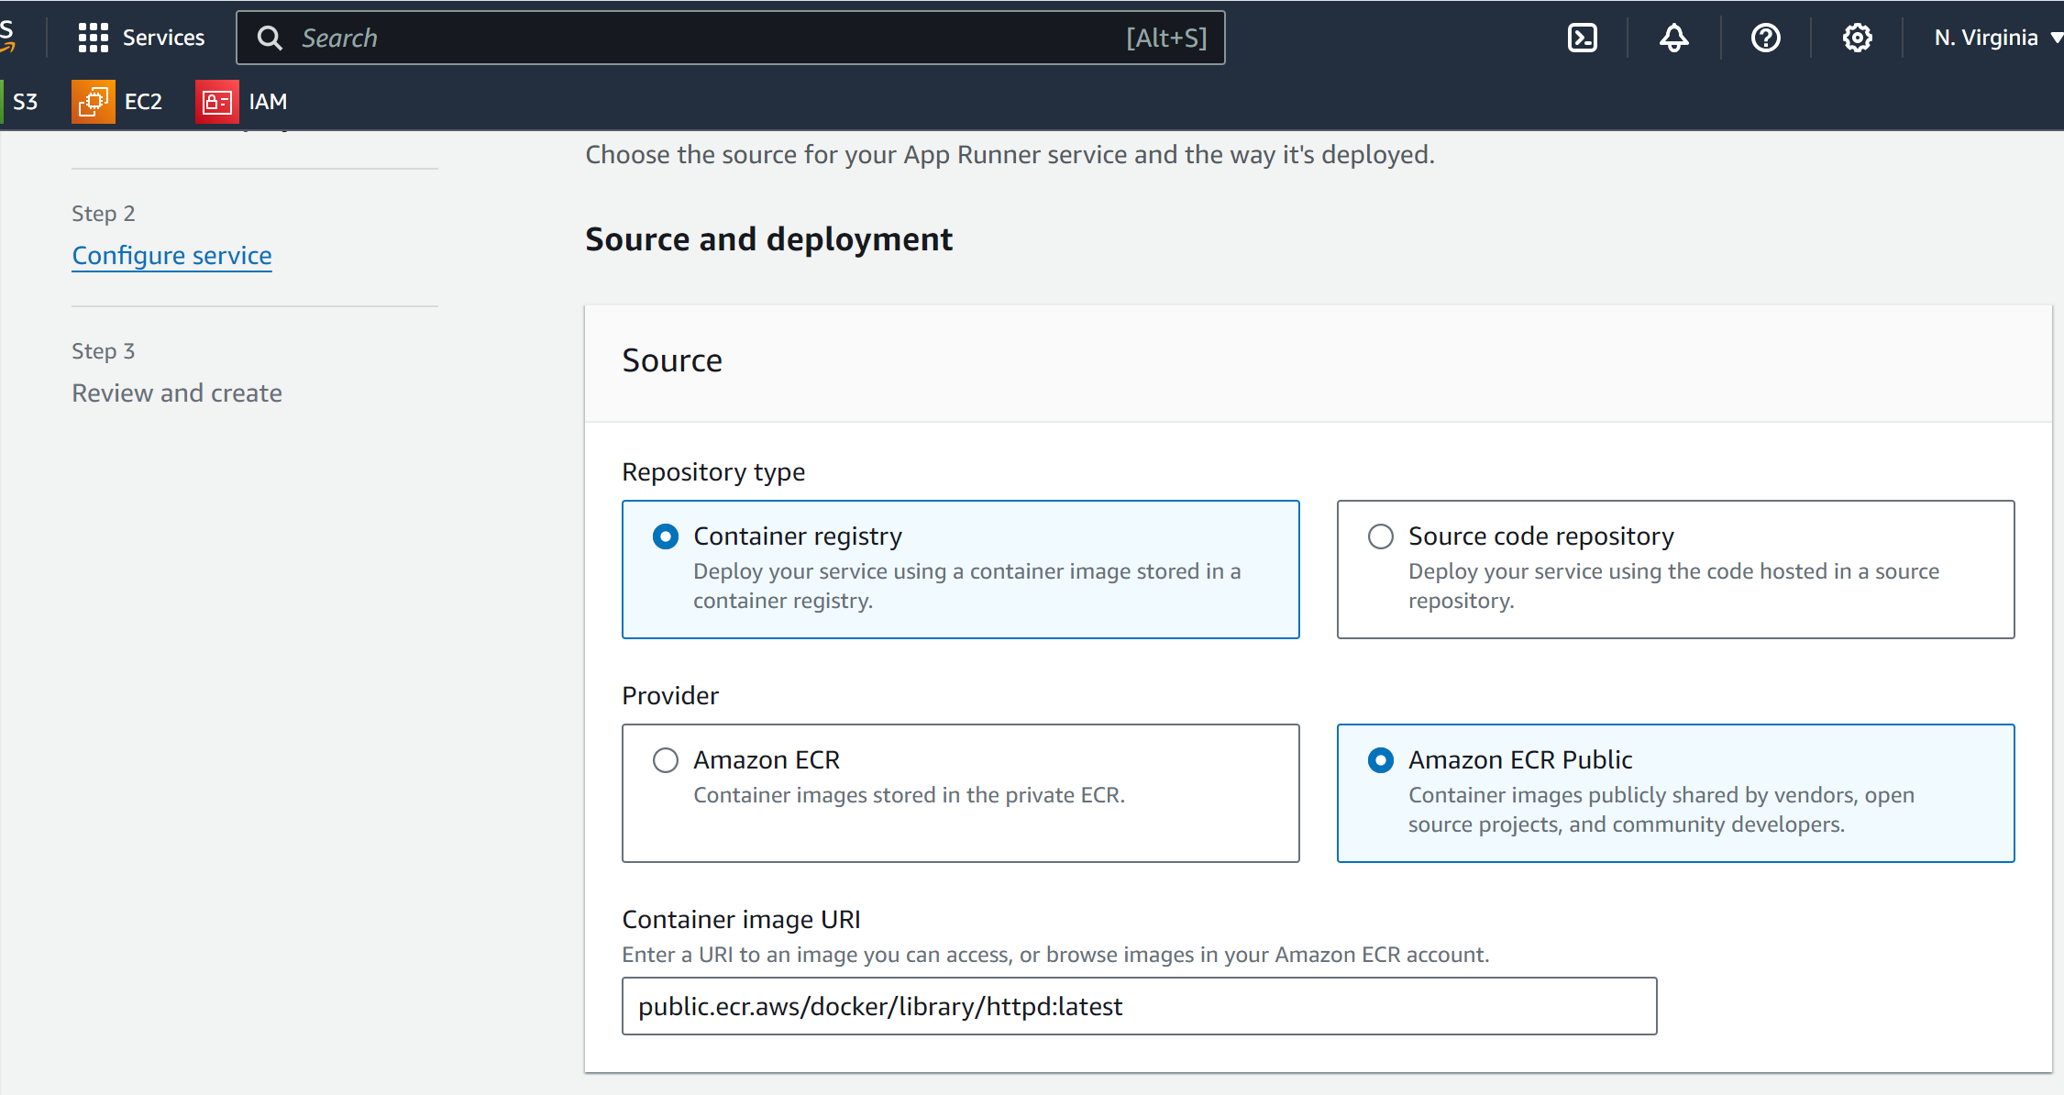
(1) Create App runner

Slide 43
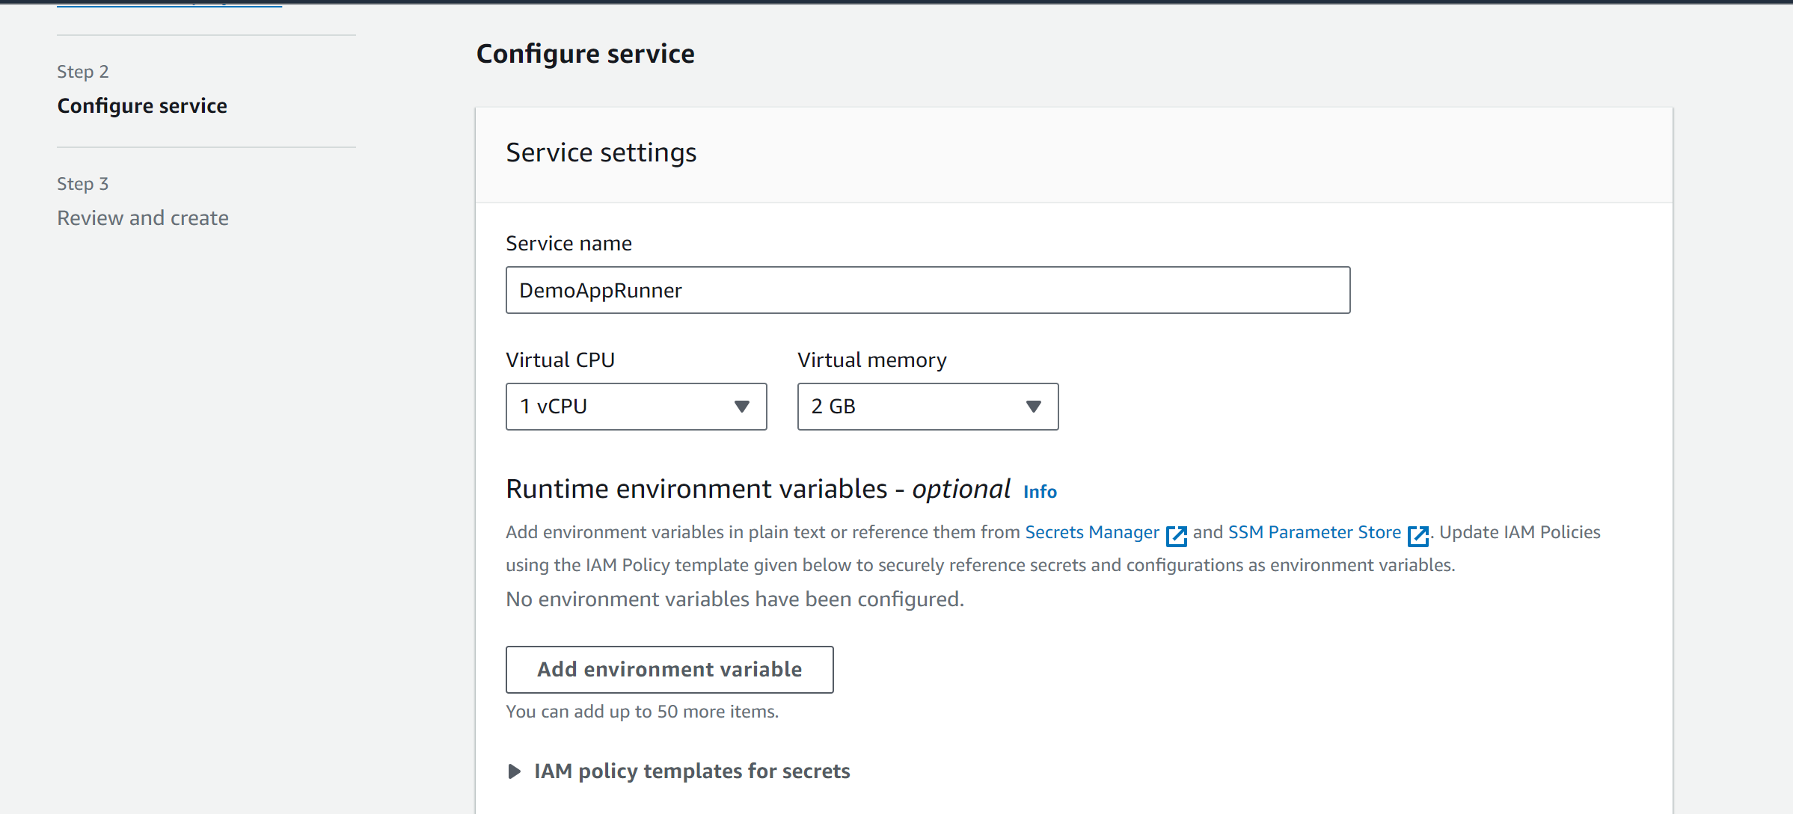
(1) Create App runner

Slide 44
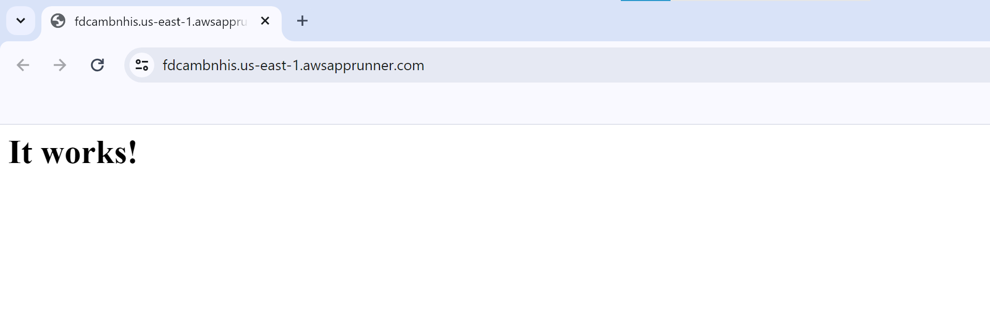
(2) Check result

Slide 45
Lambda/Api gateway

Slide 46
Hands-on
CloudFrond vs S3

Slide 47
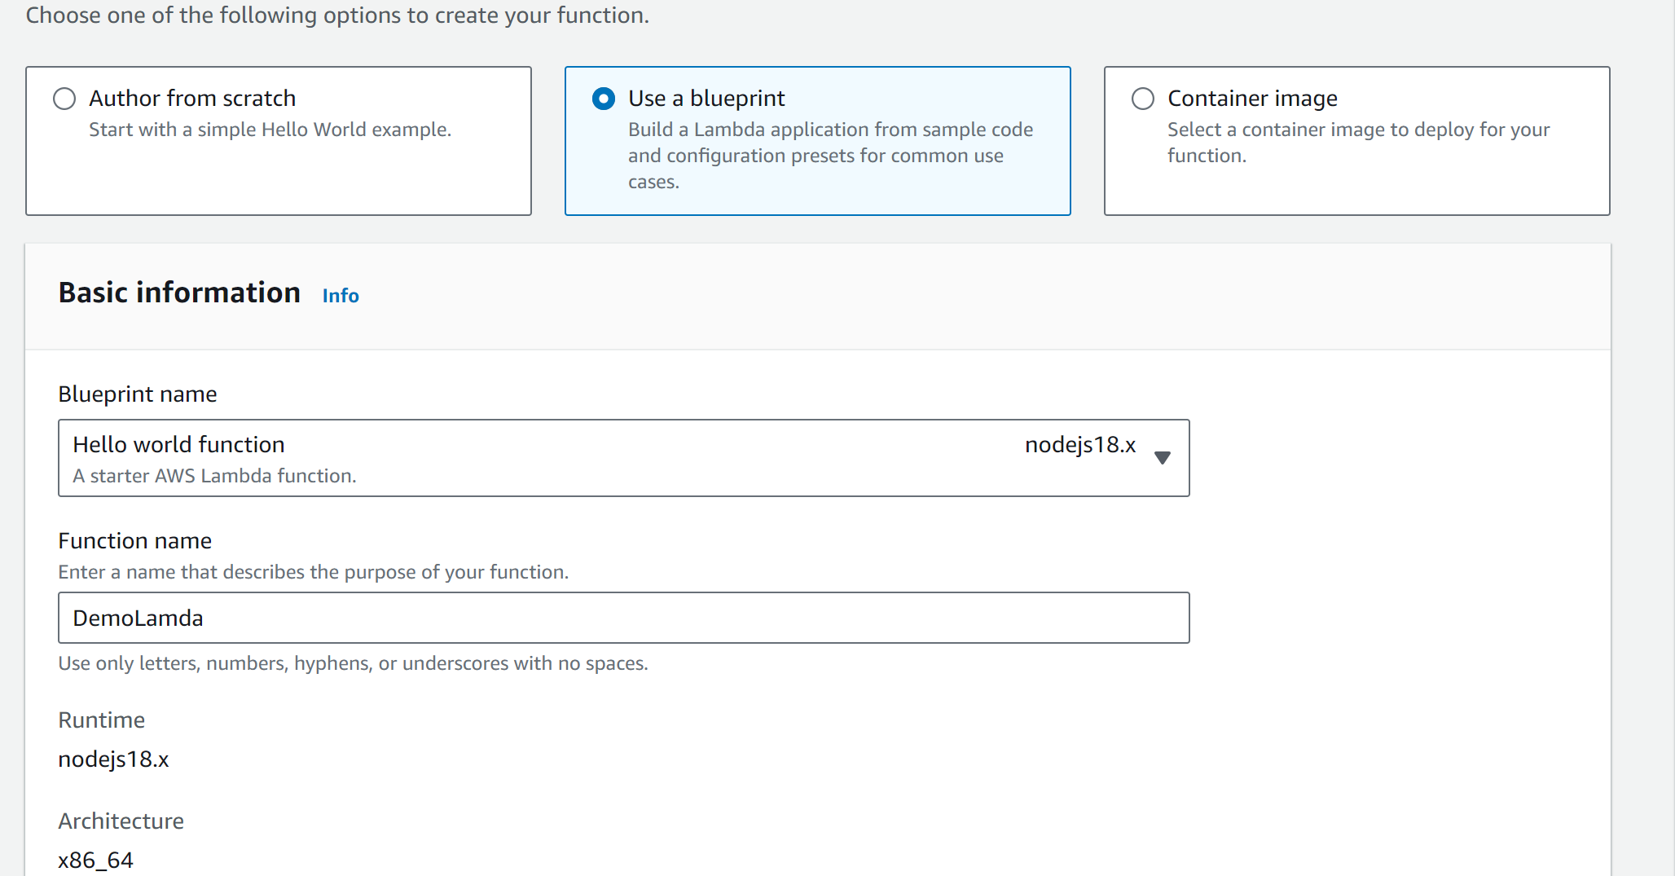
(1) Create function

Slide 48
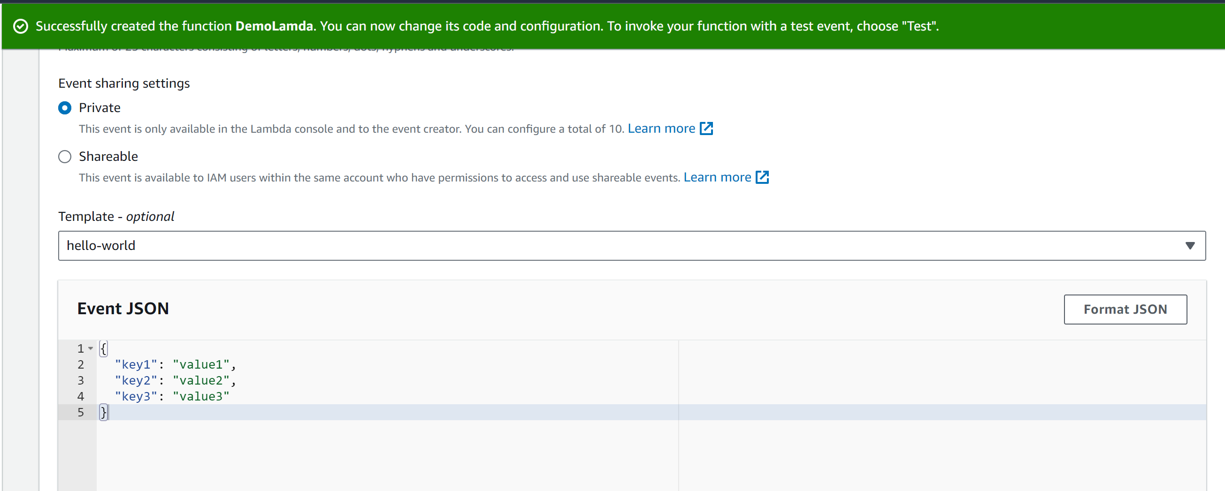
(2) Create test event

Slide 49
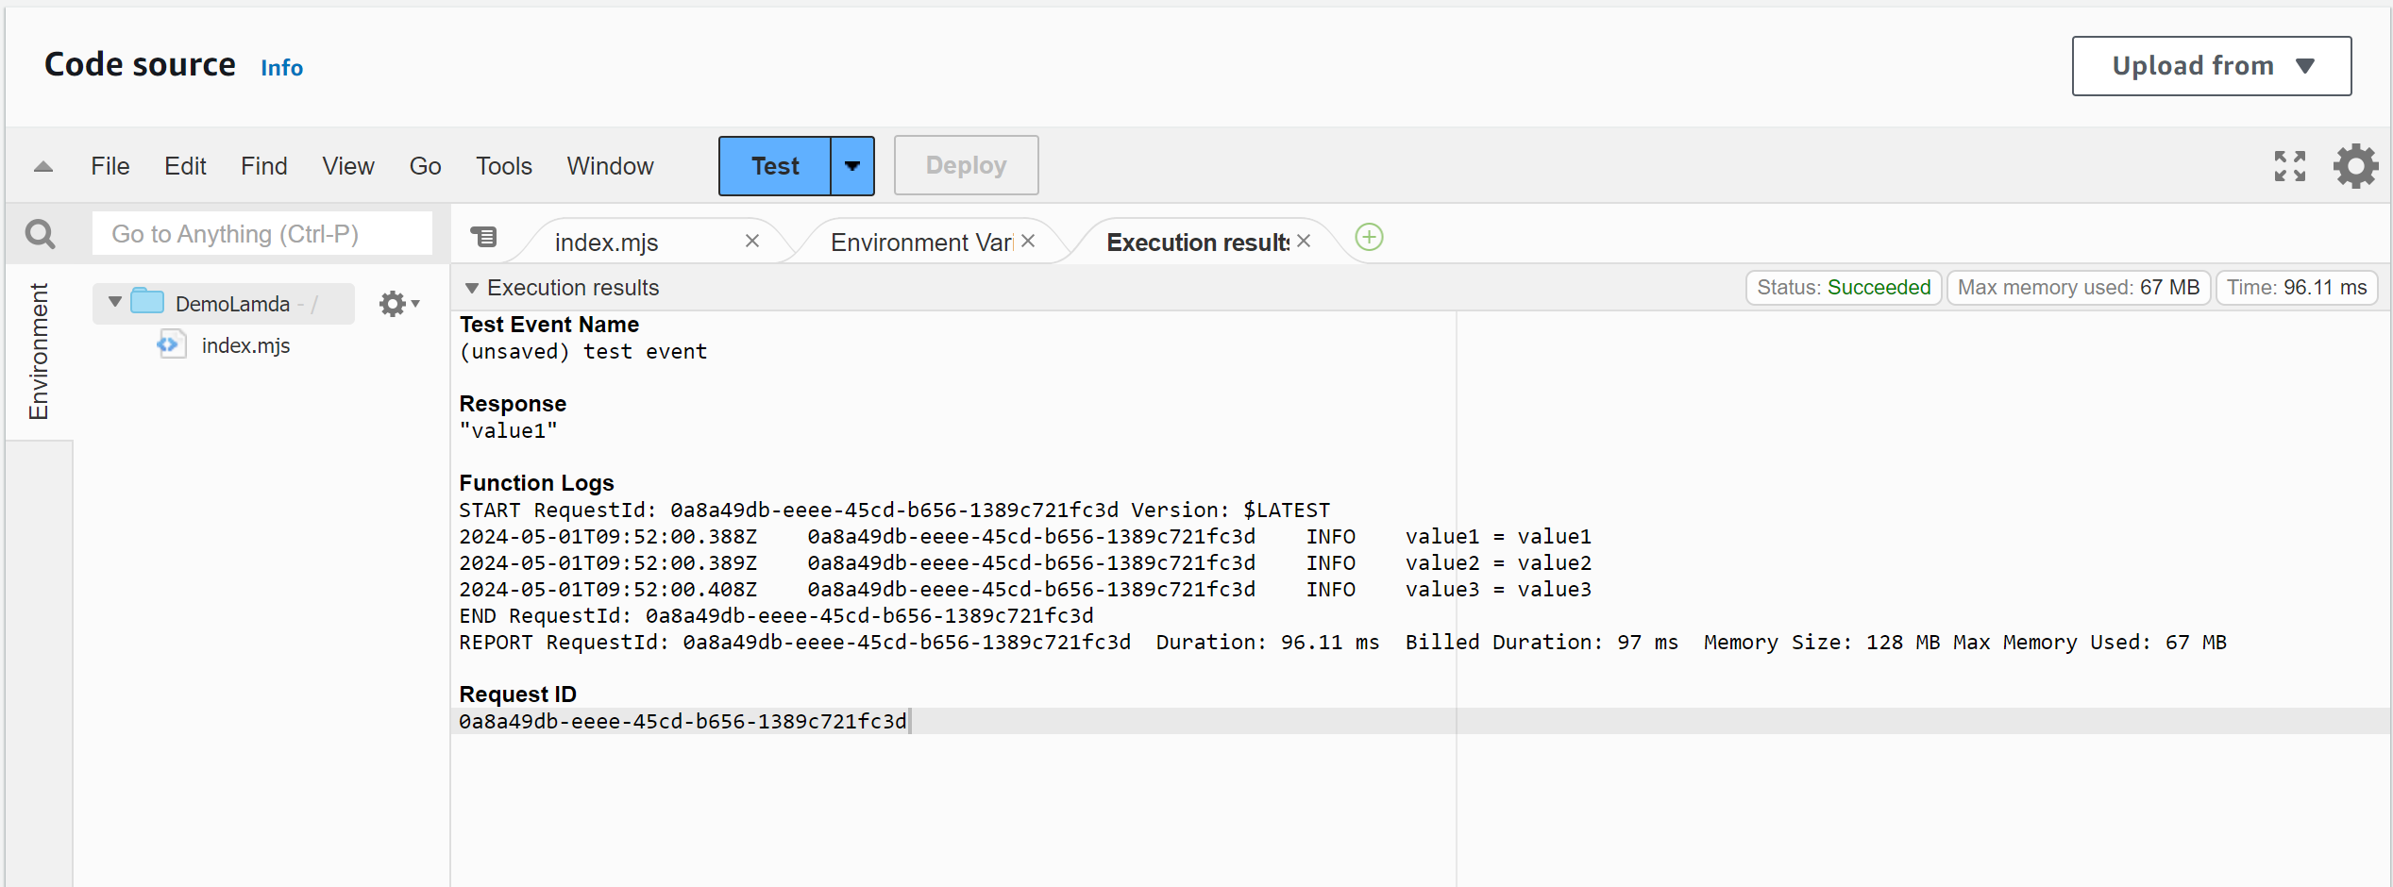
(2) Test event

Slide 50
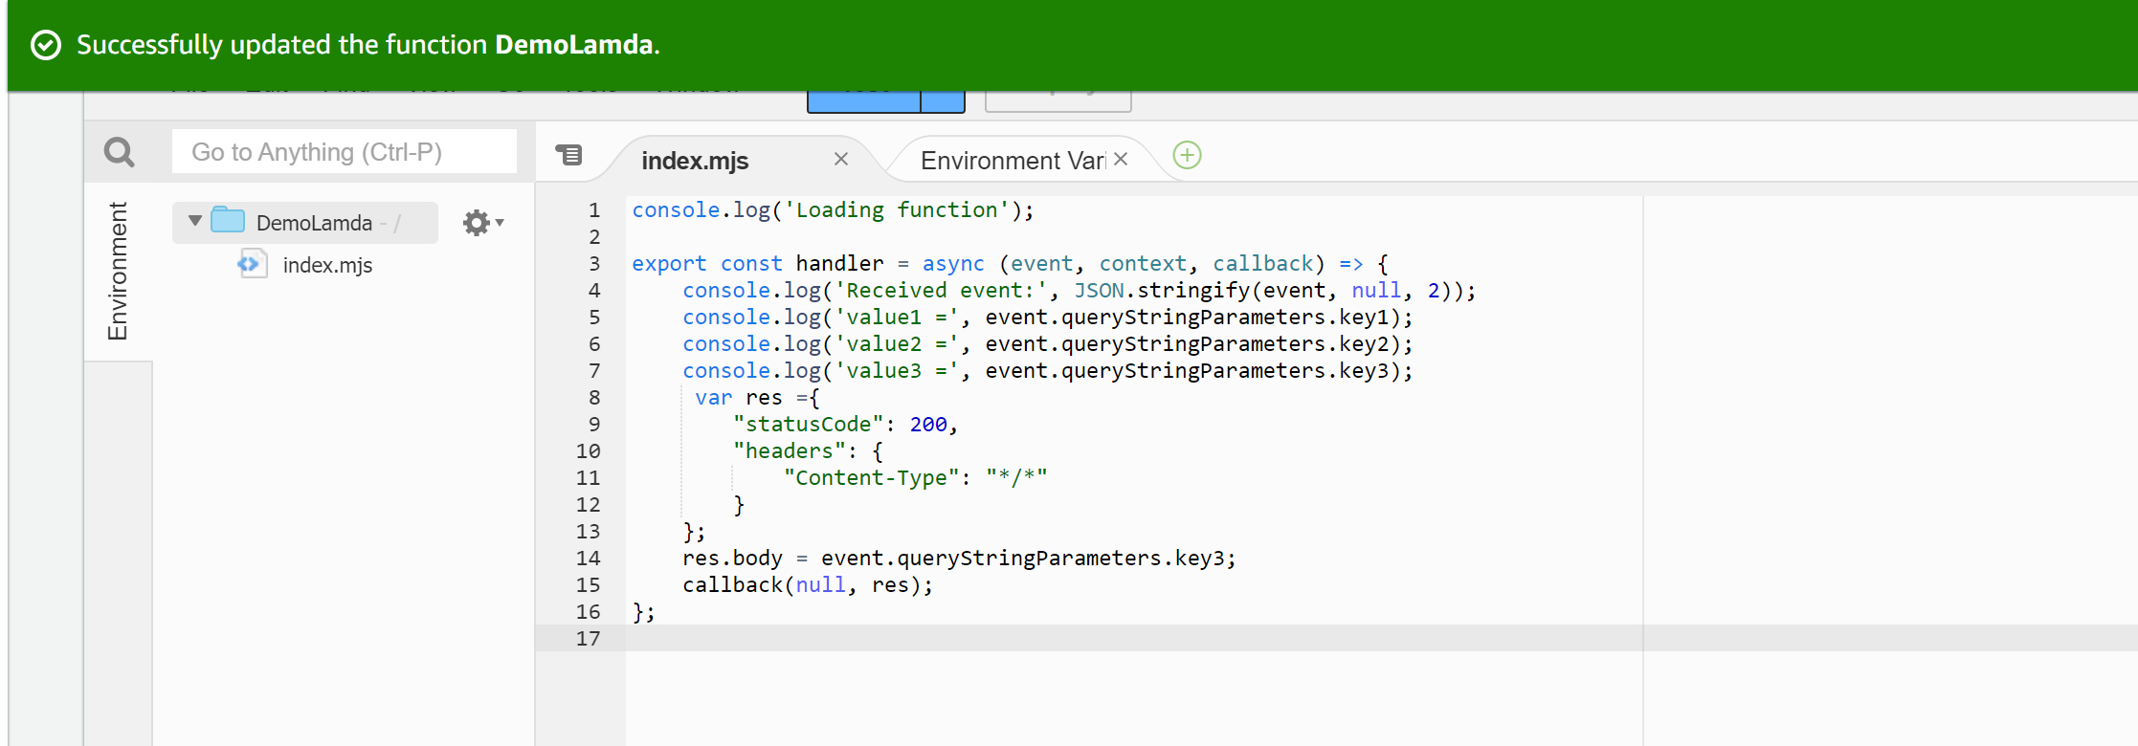
(3) Update handler

Slide 51
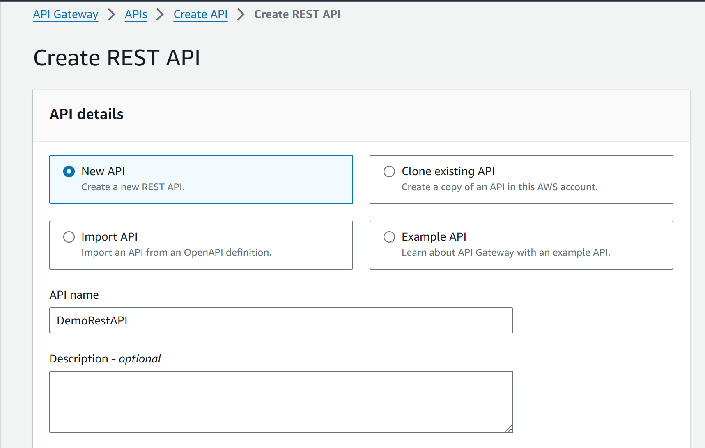
(3) Api gateway – Create REST API

Slide 52
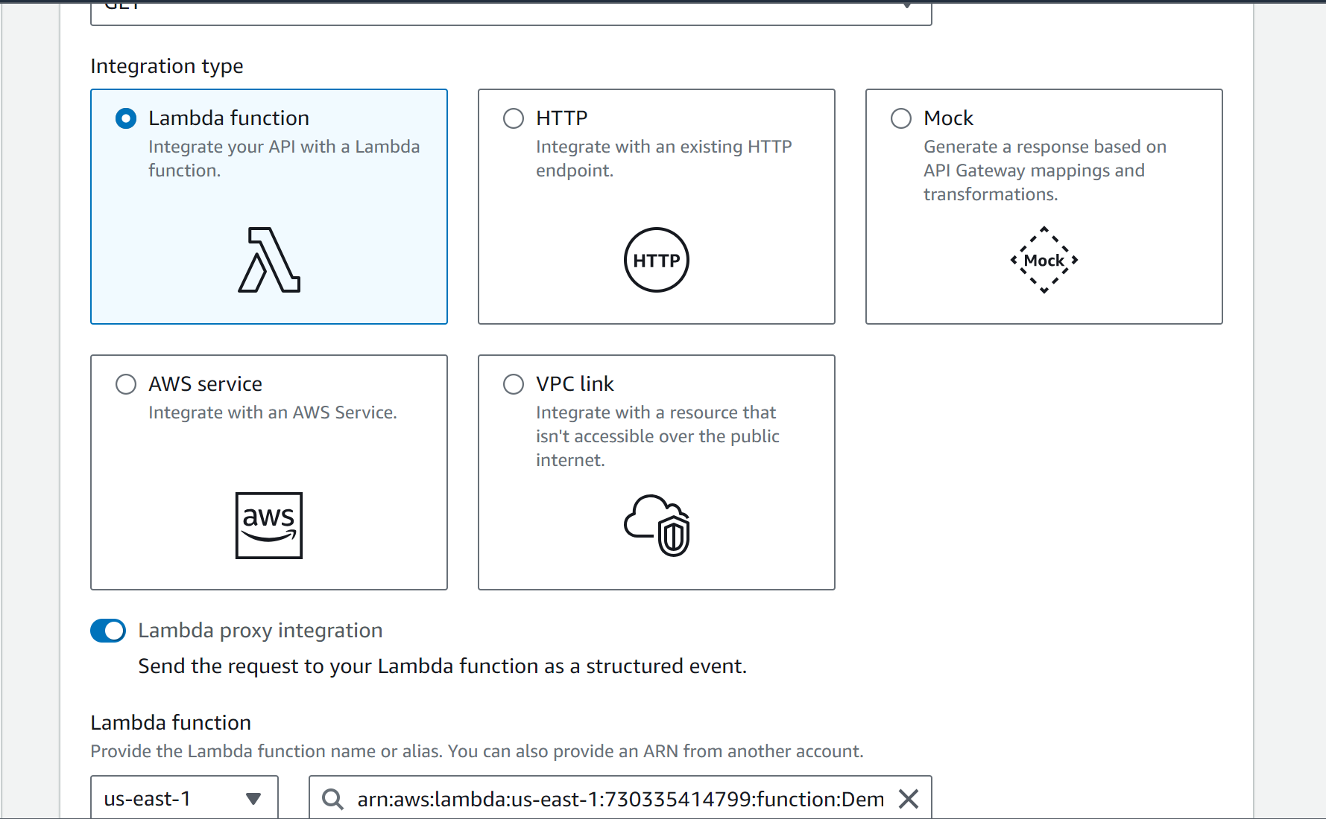
(3) Api gateway – Create method

Slide 53
(3) Api gateway – Create method

Slide 54
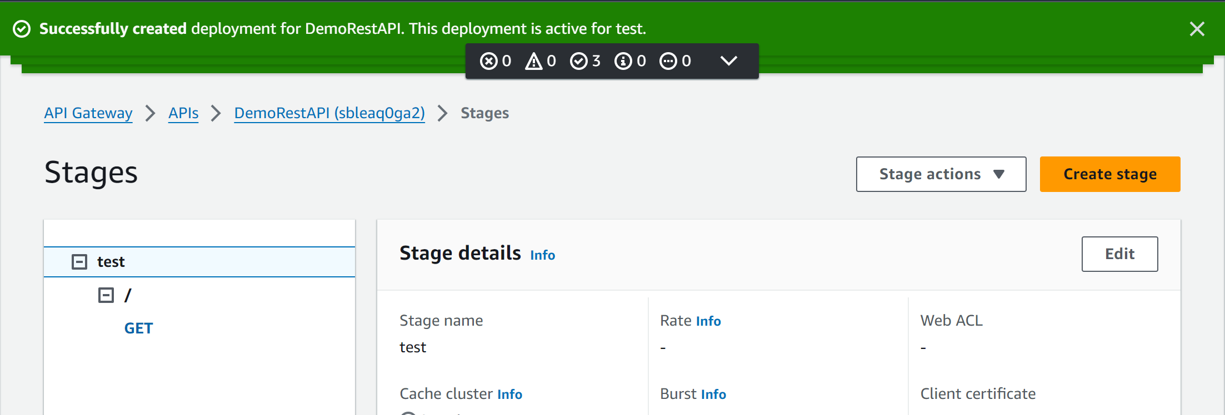
(5) Api gateway – Deploy API

Slide 55
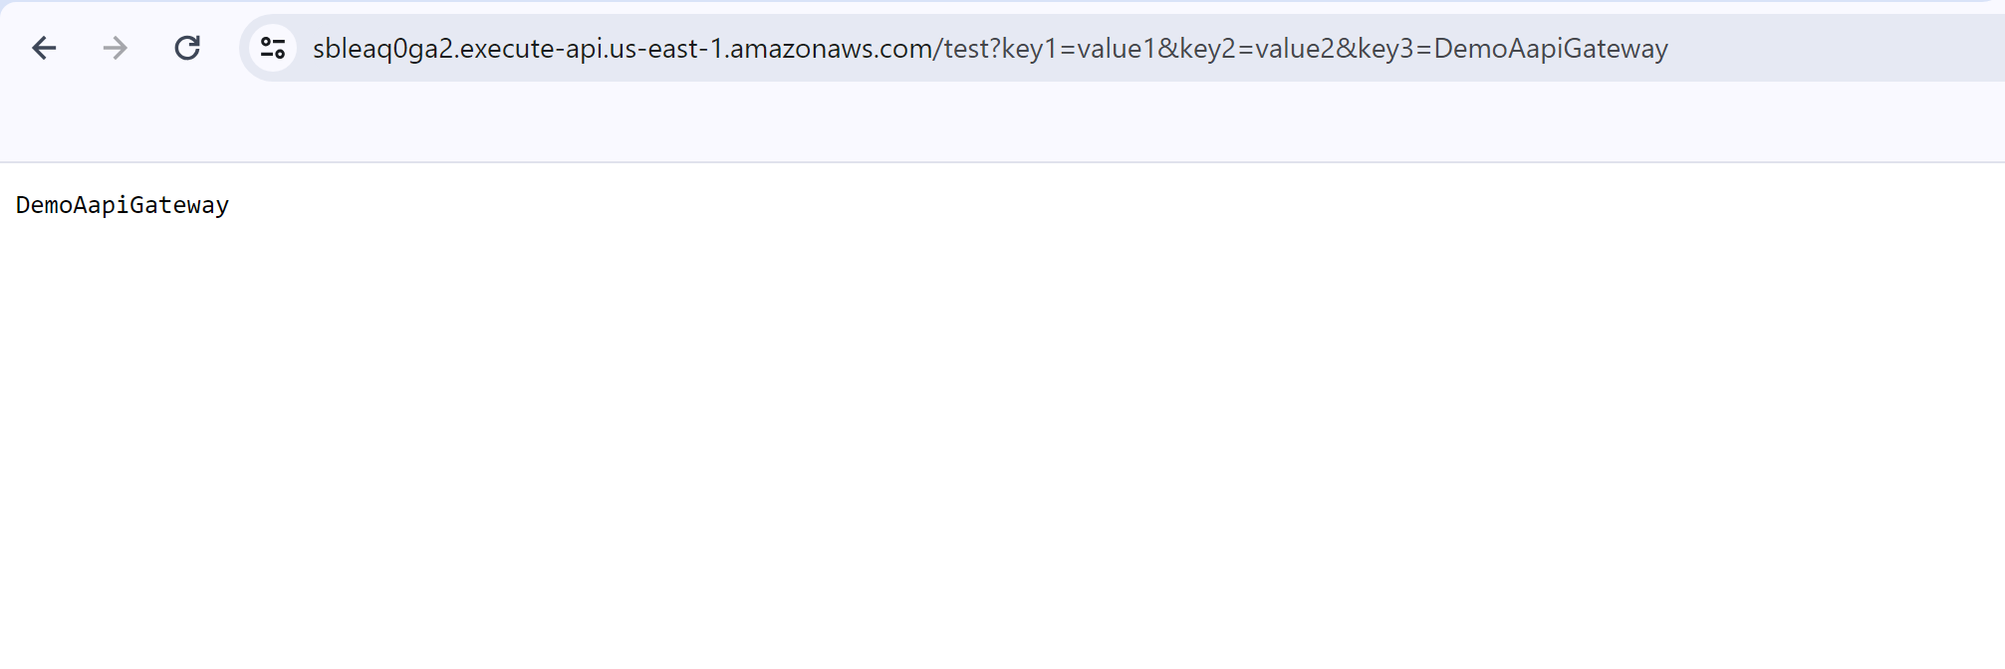
(5) Api gateway – Check result

Slide 56
Next week
Appsync

